Slide 1

EMBEDDED SYSTEMS
Self-Healing Wireless Sensor Network
For Agricultural & Industrial Monitoring Using Adaptive Mesh Routing
STM32 · LoRa (SX1278) · Adaptive Mesh Routing · Fault Tolerance

Slide 2

The Problem: Single Point of Failure
Fixed-Path Networks
One Node Fails
Node1 → Node2 → Node3 → Gateway
Entire downstream data path collapses
Result
Complete data loss, no recovery, manual intervention required

Slide 3

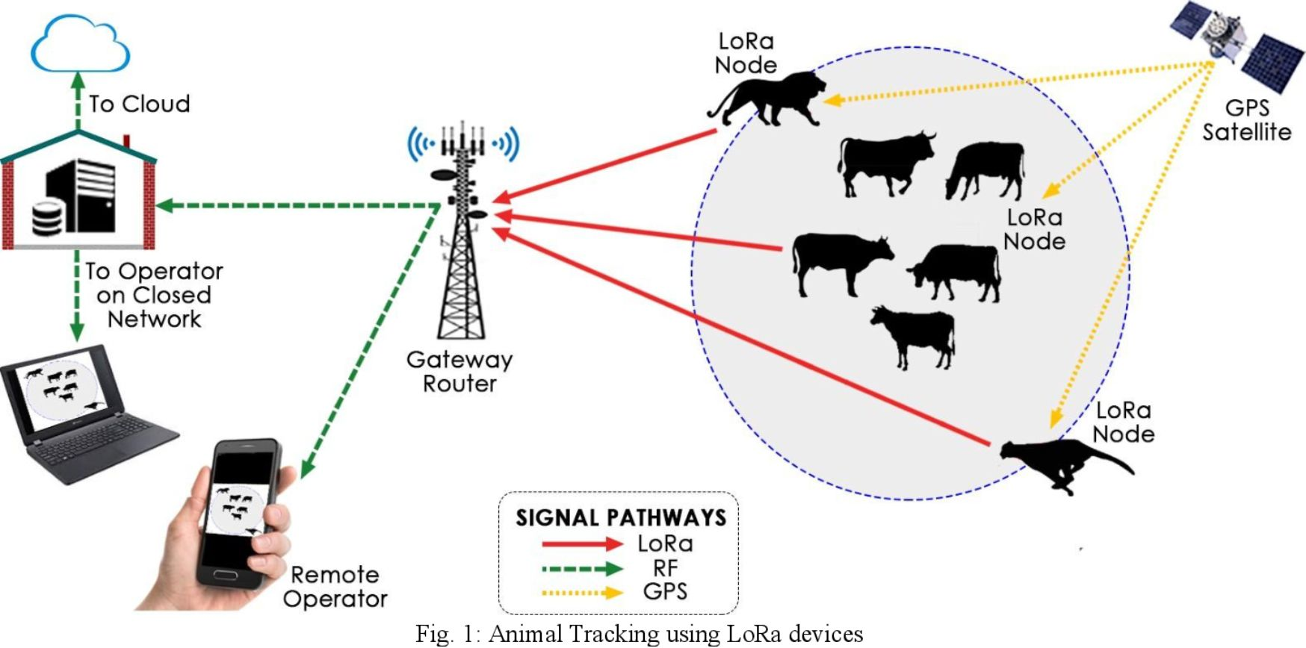

Project Objective
10-Node Mesh
STM32 + LoRa sensor nodes in adaptive mesh topology
Automatic Fault Detection
Heartbeat-based monitoring, zero manual intervention
Instant Rerouting
Dynamic path reconstruction around failed nodes
Low Cost
Target under ₹15,000 total hardware cost

Slide 4
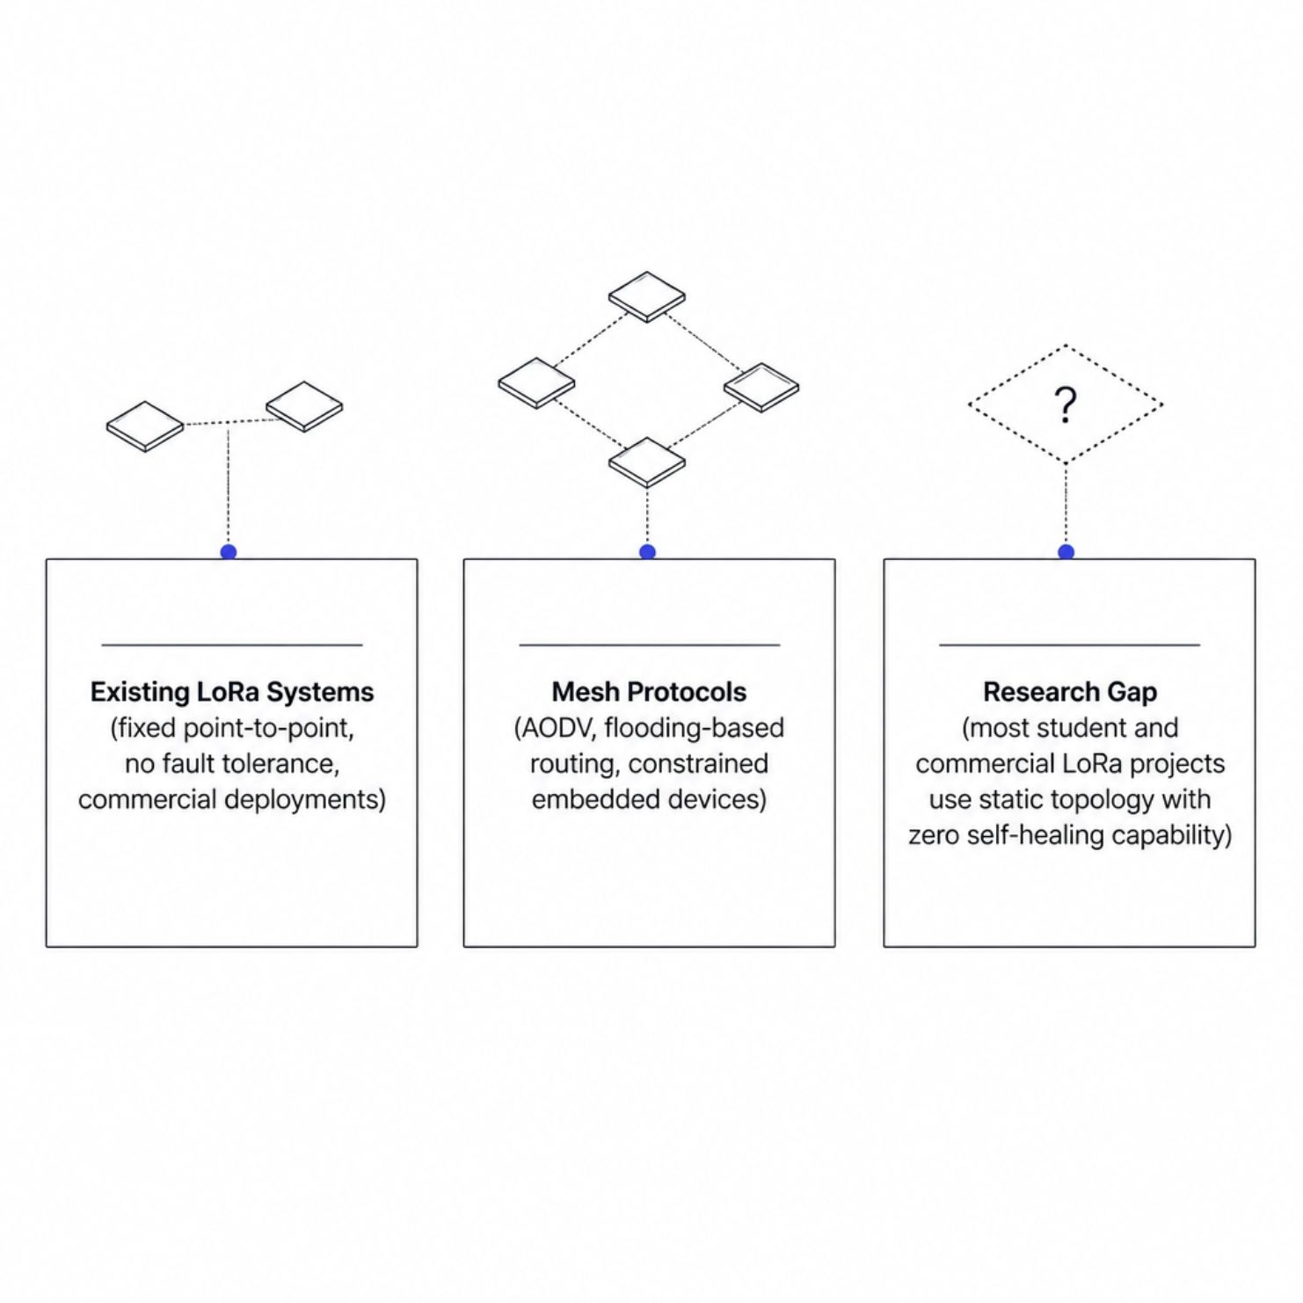
Literature Survey & Research Gap
What Exists
LoRa-based agricultural monitoring — fixed paths only
AODV & flooding protocols — theoretically sound, rarely embedded
Commercial LoRaWAN — star topology, no mesh redundancy
The Gap
No student-grade implementation of distributed, self-healing mesh routing on resource-constrained STM32 + LoRa hardware.

Slide 5
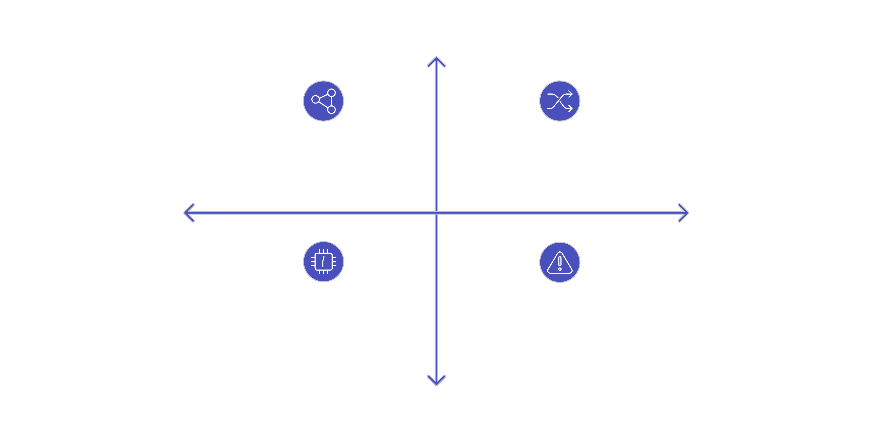
Proposed System Architecture
High Connectivity
Before Failure: Node1→Node2→Node3→Gateway
After Failure: Node1→Node3→Gateway (reroute)
Fault Detection
Automatic Reroute
Mesh Health: 10 STM32 LoRa nodes active
Failure Event: Node2 offline, detected automatically
Redundancy
10 STM32 + LoRa nodes form an adaptive mesh. When Node2 fails, the network autonomously reroutes via Node3 — zero data loss, zero manual action.

Slide 6
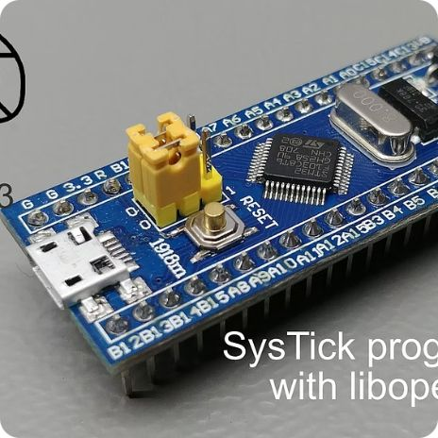
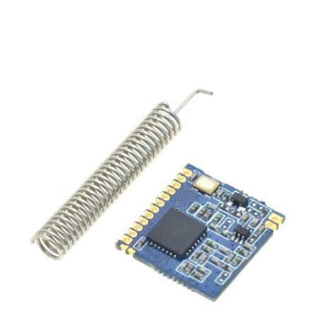
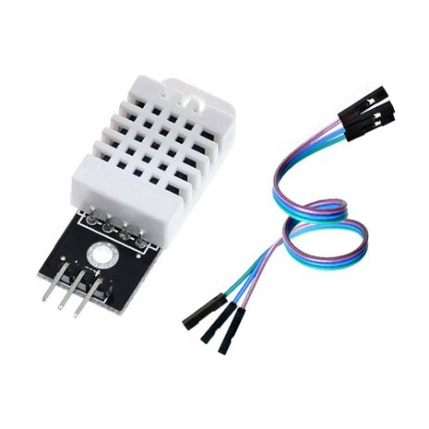
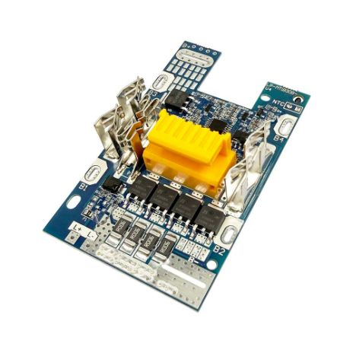
Node Hardware Design
STM32 MCU
LoRa Transceiver
Sensor Interface
Power Management
ARM Cortex-M3, 72 MHz, 64 KB Flash — routing stack + sensor processing
SX1278 / RFM95, 433 MHz, long-range, low-power RF link
DHT22, soil moisture, voltage — configurable per deployment
Li-ion battery, voltage monitoring, low-power sleep modes

Slide 7
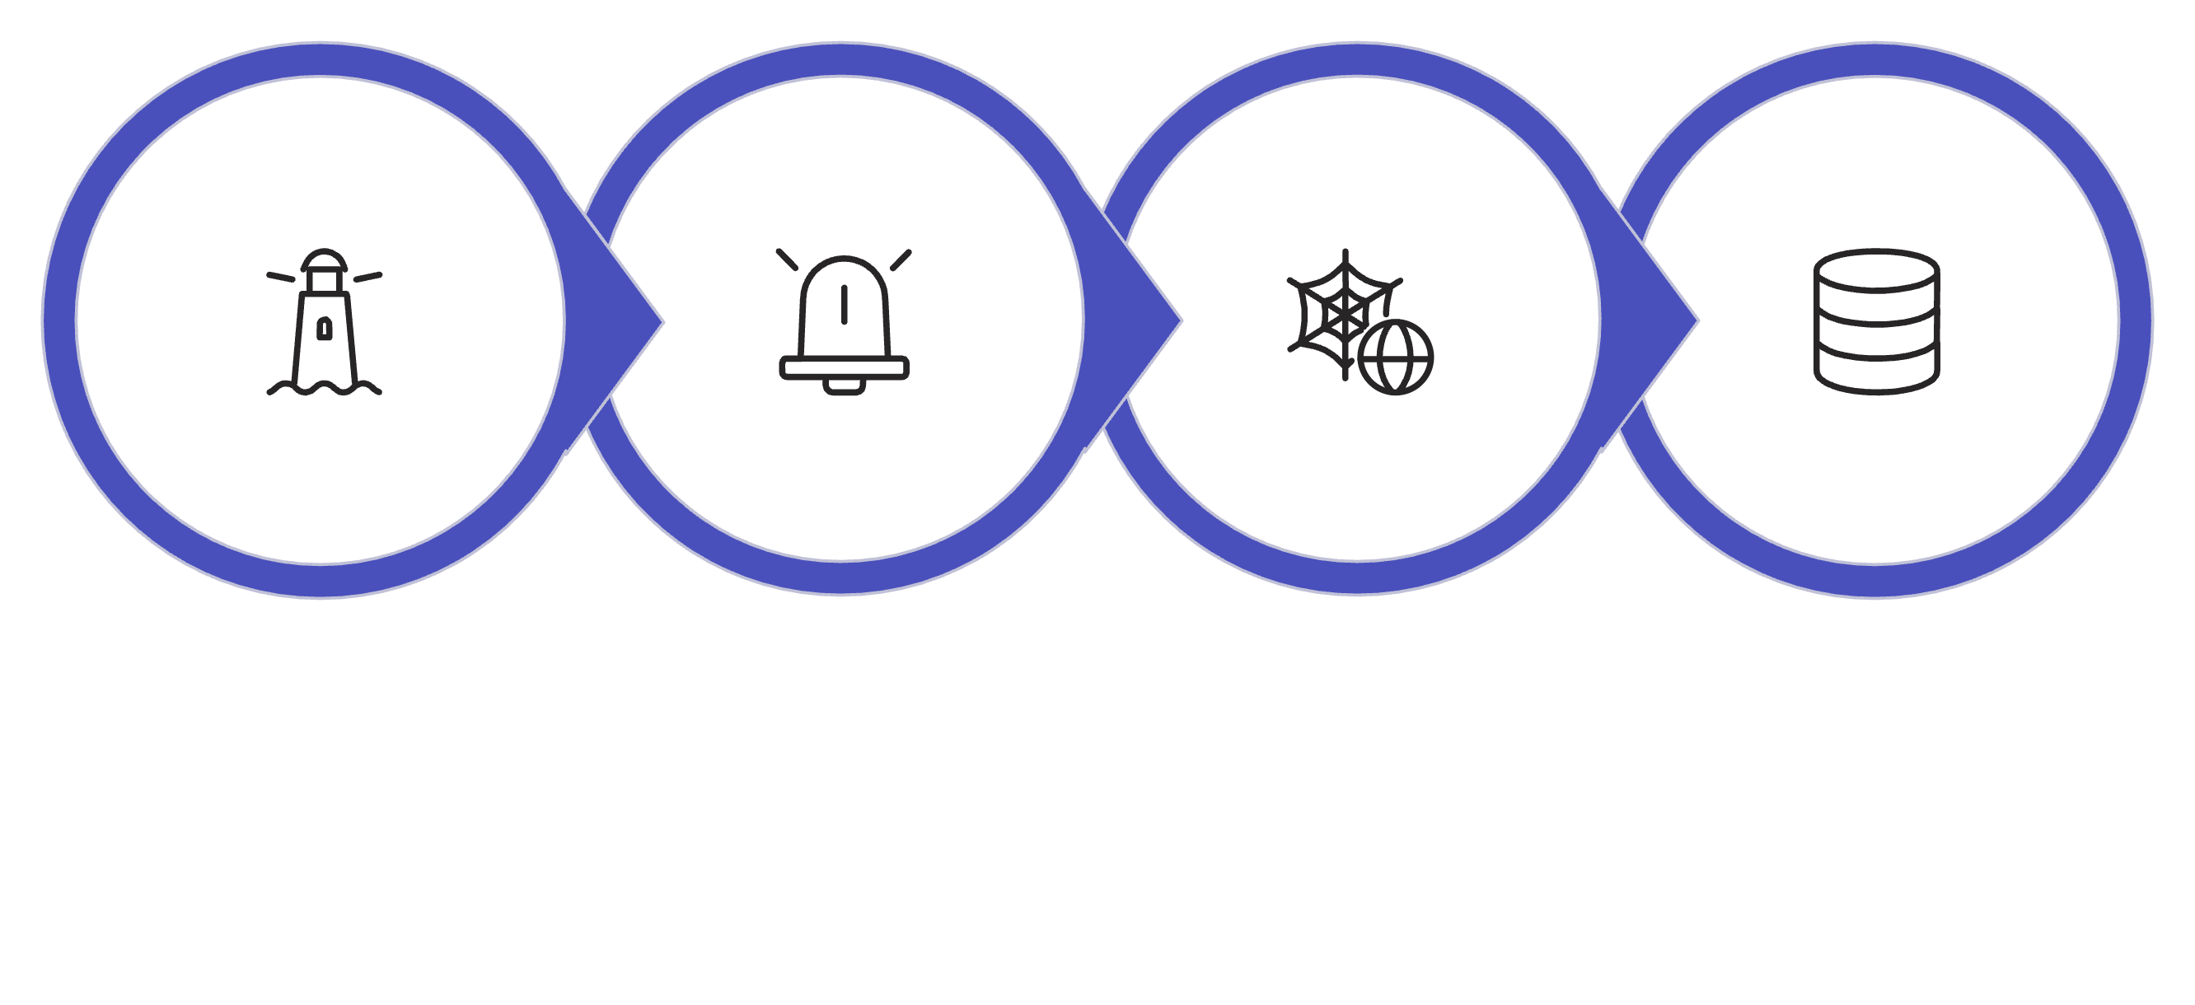
Routing & Self-Healing Algorithm
Route Discover
Heartbeat
Fault Detect
Table Update
Heartbeat interval: 5 s · Failure threshold: 3 missed beacons · Re-discovery: flood-based RREQ/RREP

Slide 8
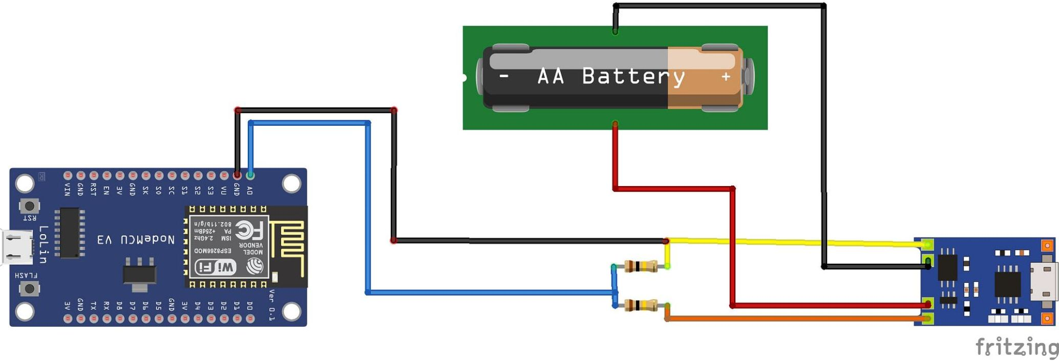
Battery-Aware Routing
Beacon Payload
Each heartbeat includes remaining battery %
Proactive Avoidance
Nodes below 20% excluded from routing table
Network Lifetime
Extends overall network uptime by avoiding weak links

Slide 9
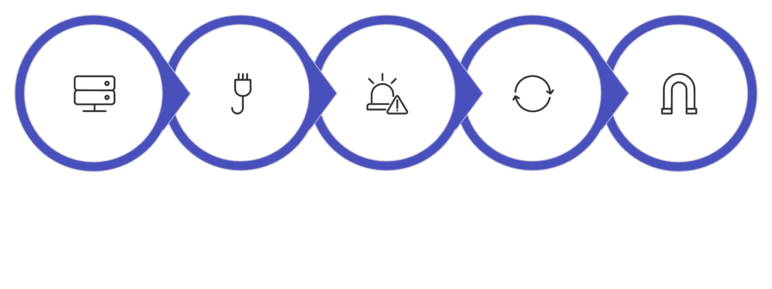
Methodology & Expected Results
Deploy 10 Nodes
Normal Mesh
Inject Failure
Self‑Reconfigure
Deliver to Gateway
End-to-end flow from field deployment through fault injection to verified data delivery at gateway.
Hardware
Key Metrics
Component
Qty
Cost
Recovery time: < 10 s target
Packet delivery ratio: > 90%
Routing overhead: < 15%
Per-node power: < 50 mW avg
STM32 Board
10
₹4,000
LoRa Module
10
₹3,500
Sensors + Power
10
₹4,500
Total
—
~₹12,000

Slide 10
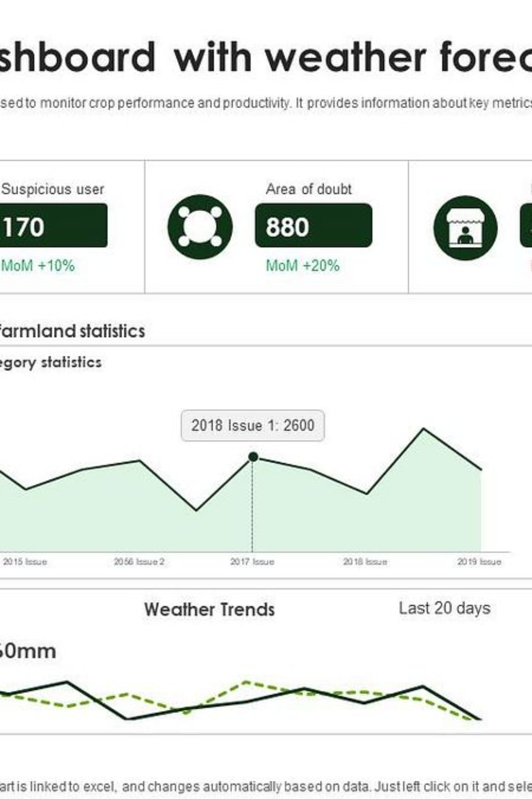





Applications, Novelty & Future Scope
Precision Agriculture
Industrial IoT
Disaster-Resilient Networks
Smart Infrastructure
Novelty: Distributed self-healing mesh routing on resource-constrained STM32 nodes — beyond typical fixed-topology LoRa projects.
Future: Scale to 50+ nodes · ML-based failure prediction · Cloud dashboard integration

